Slide 1



VIDEO GAME SALES PROJECT
ENYI ANN NKEM
JUAN VIRSEDA

Slide 2
GOALS
We Will explore a video game sales dataset with 16000+ entries, which contain a ranking of games that have sold at least 100,000 units.We Will model and give a thorough analysis of this project.

Slide 3
key insights to explore
Year with higher Game Releases
Popular Game Genre between 1980 - 2020
Popular Game Genre in the Top 3 Selling Years
Top 10 Publishers with highest number of game releases
Popular Game Genre of the 3 Top Selling Publishers
Top 10 Gaming Platforms with highest number of game releases
Popular Game Genre of the 3 Top Gaming Platforms
Year with Highest Sales Worldwide
Top 10 Game with Highest Worldwide Sale
Top Game Genres with Highest Worldwide Sale
Top Game Publisher with Highest Worldwide Sale
Sales Comparison by Sales Area

Slide 4
EXPLORING DATA analysis
This dataset contains a list of video games with sales greater than 100,000 copies.
Matrix column entries (attributes):
Rank - Ranking of overall sales
Name - The games name
Platform - Platform of the game’s release (i.e. PC,PS4, etc.)
Year - Year of the game’s release
Genre - Genre of the game
Publisher - Publisher of the game
NA_Sales - Sales in North America (in millions)
EU_Sales - Sales in Europe (in millions)
JP_Sales - Sales in Japan (in millions)
Other_Sales - Sales in the rest of the world (in millions)
Global_Sales - Total worldwide sales.

Slide 5
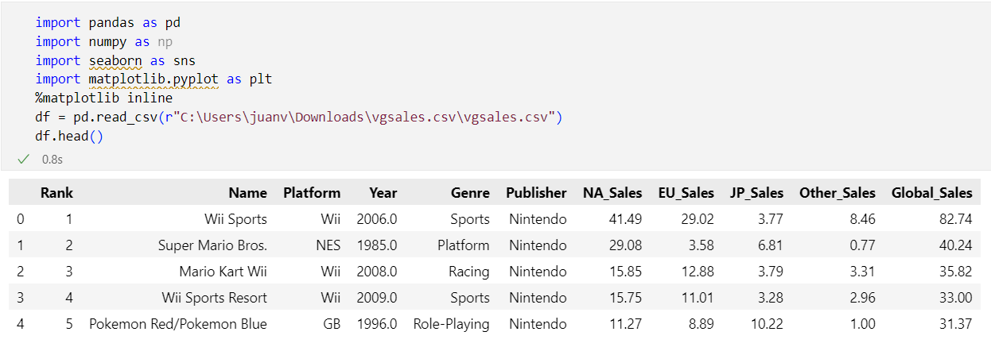
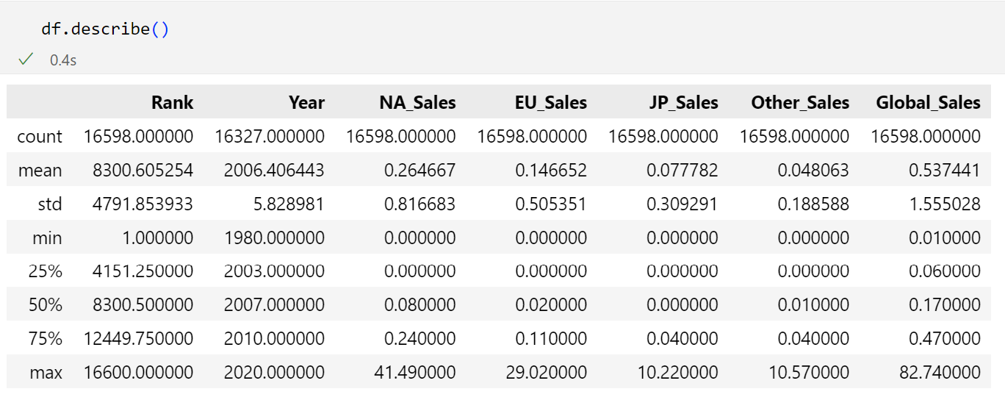
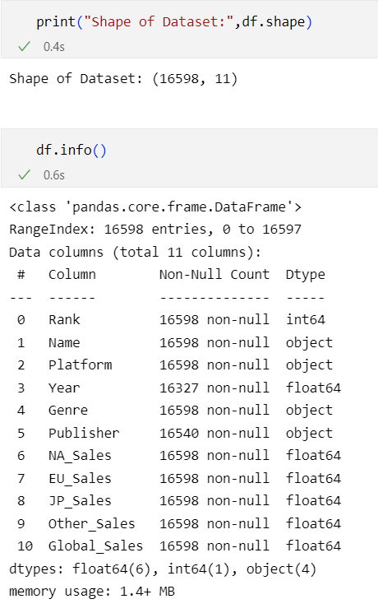
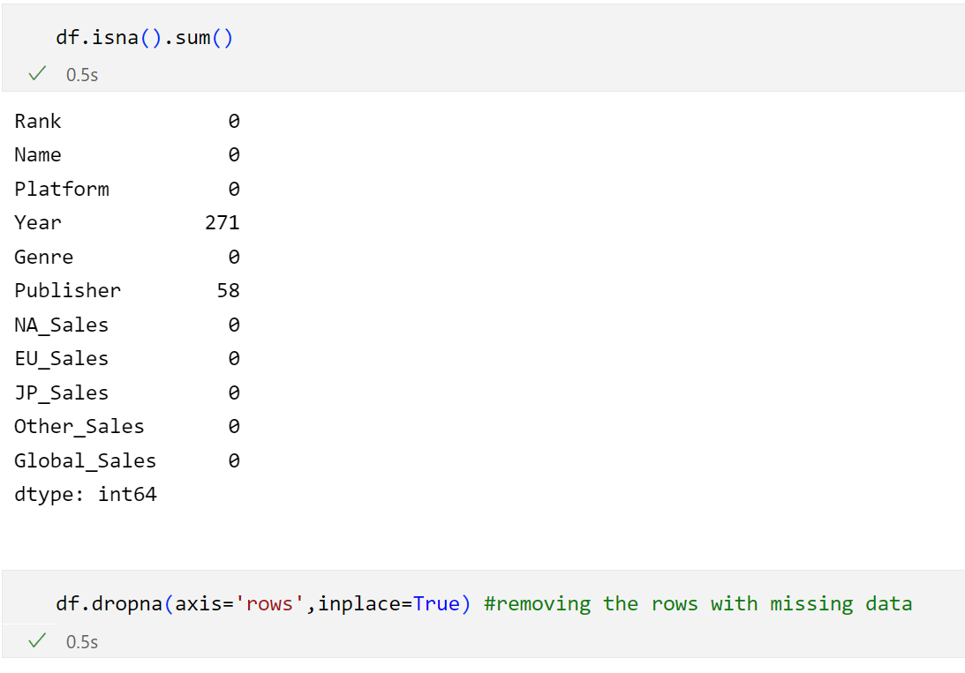
- First we import the first libraries needed and check the csv file (shape(), info(). Describe().
Then we look for nans (isna().sum()).
Beacuse the number of nans is very low, we delete them (dropna()).

Slide 6
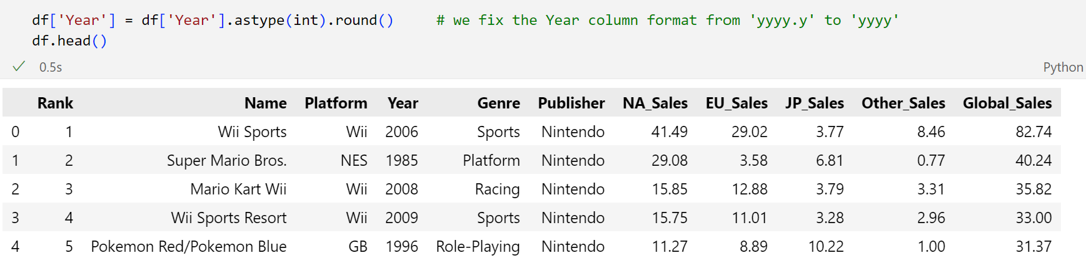
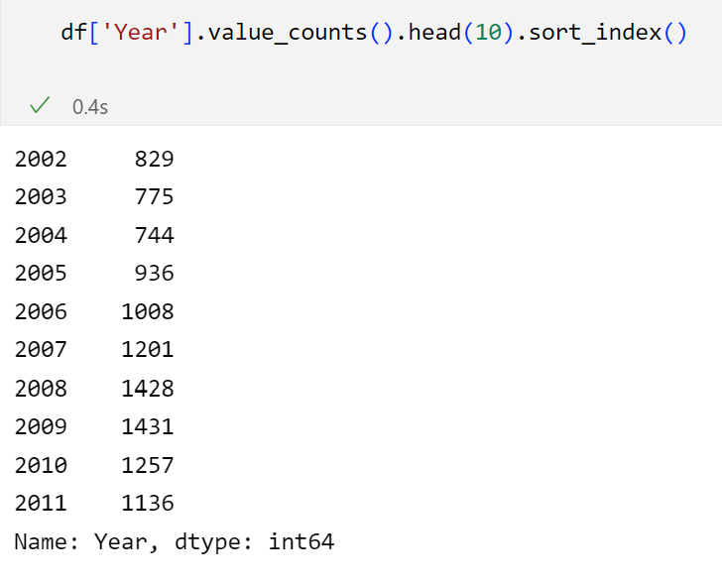
- We considered a format correction on the column ‘Year’
- And inpexct its value counts

Slide 7
How do the amount of releases relates with sales?
Important question:

Slide 8
Game releases analysis
(by count)

Slide 9
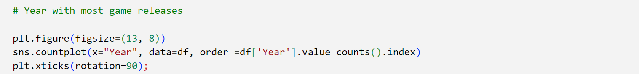
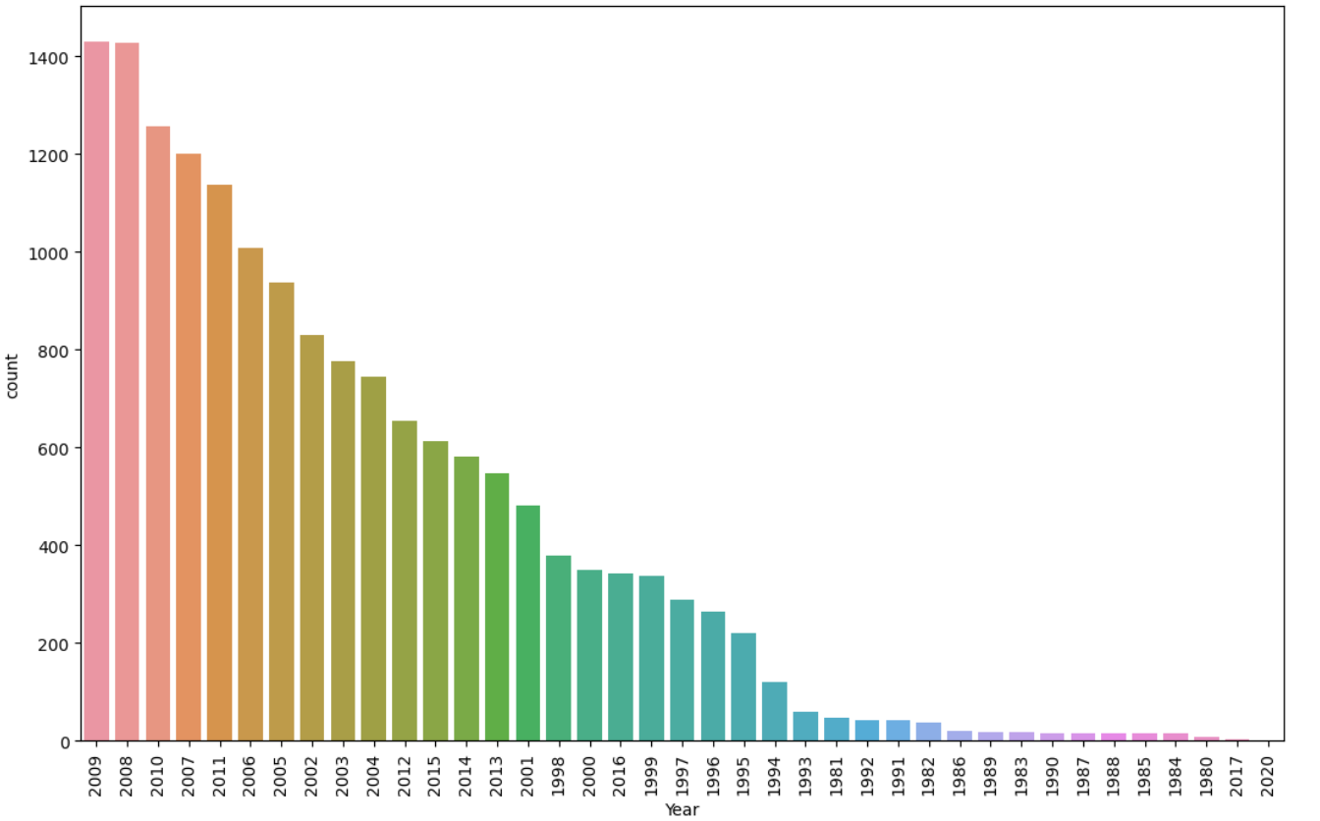
Year with higher POPULAR Game releases
- We observe that the years with more releases are 2009 and 2008.
- On the contrary, the years with less releases are 2020 and 2017.

Slide 10
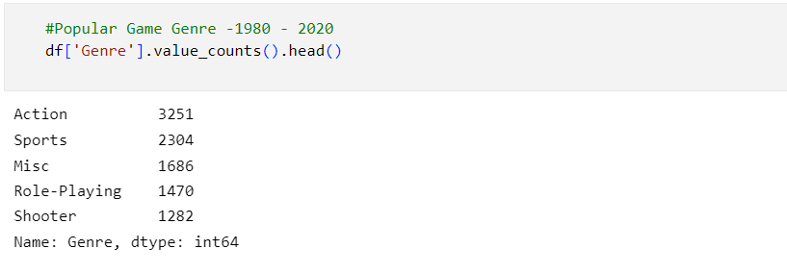
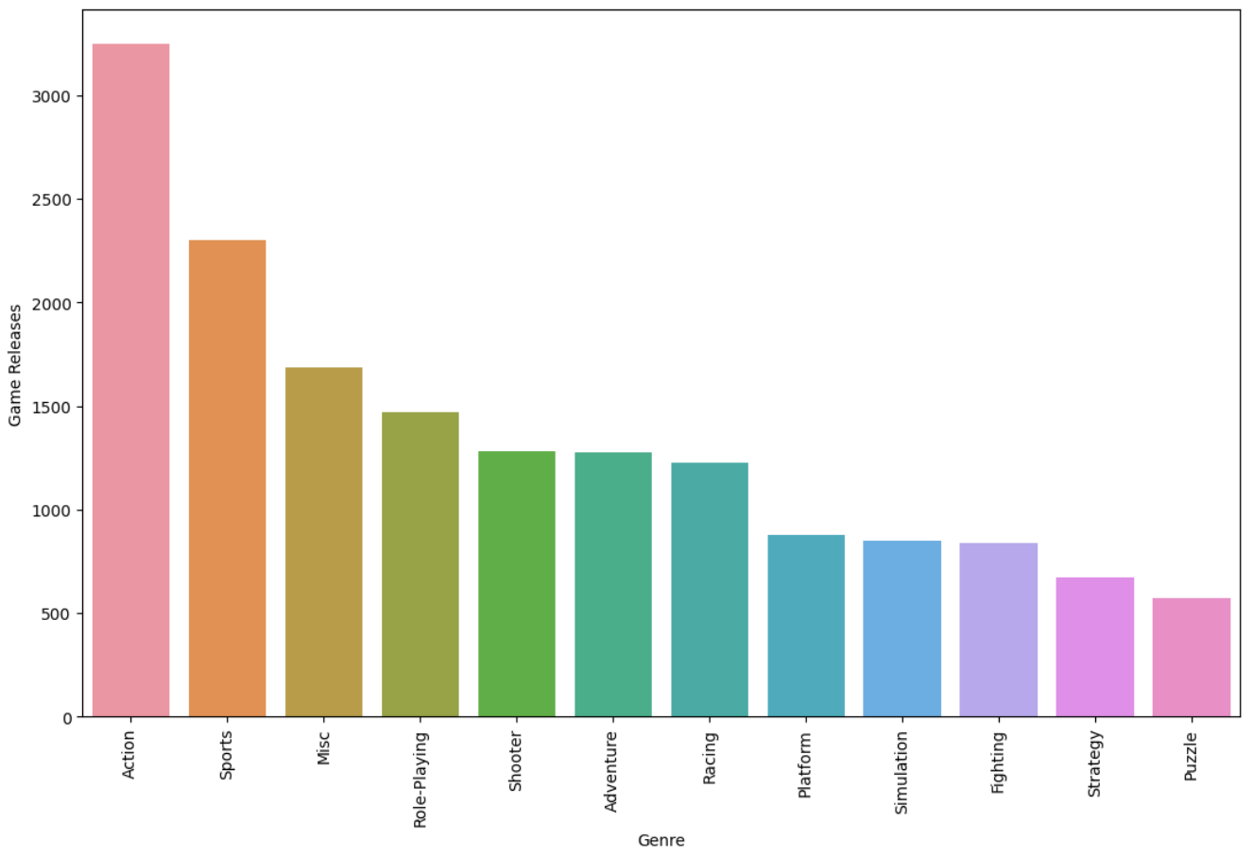
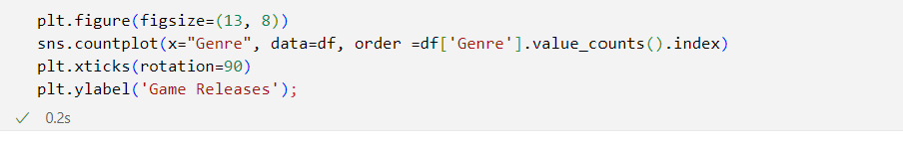
Most popular genres of all times(1980-2020)
- Value counts by genres and sorted from highest to lowest
- Graphical representation:
- The most popular genres as we can see are: Action, Sports and Misc., followed by Role-playing.

Slide 11
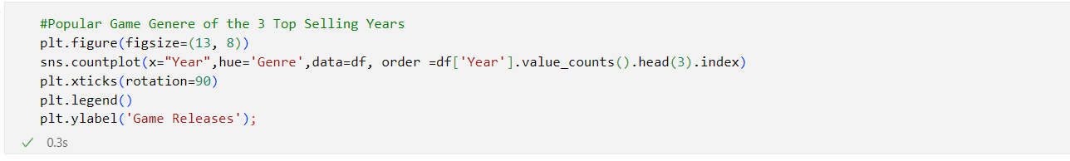
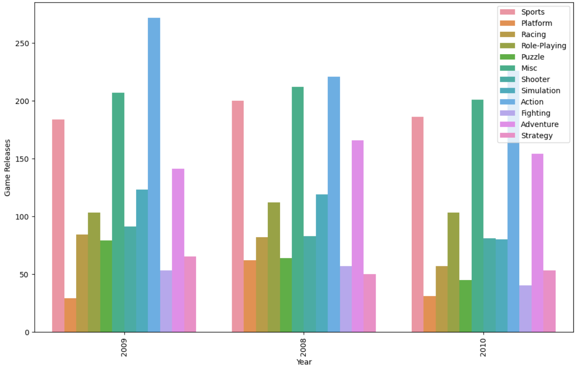
Most popular genres of top 3 years with more popular releases
Detail of the years with the most popular game releases.
Graphical representation:
We observe that Action, Misc., Sports and Adventure are the most released genres in this years.
Action and Misc. games are top released genres throughout the whole spectrum and also on top years with more popular releases.

Slide 12
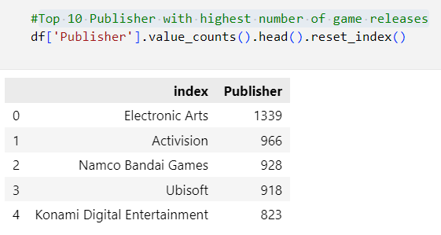
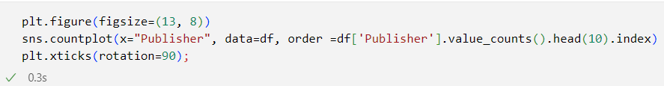
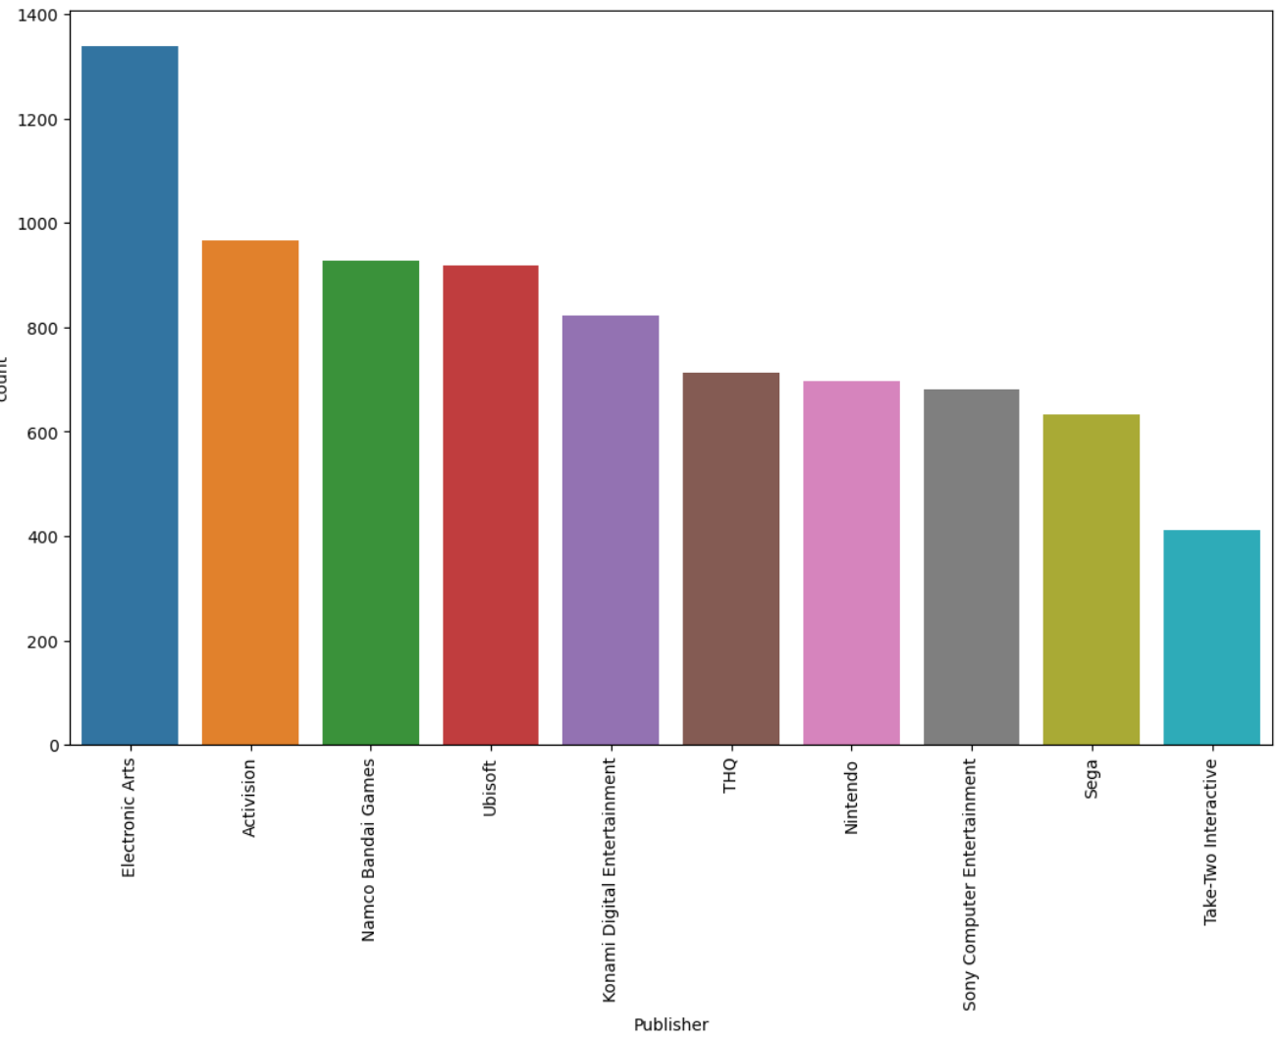
Top 10 Publisher with highest number of game releases
- An analysis of the publishers with more popular games released (that reached at least 100,000 copies sold)

Slide 13
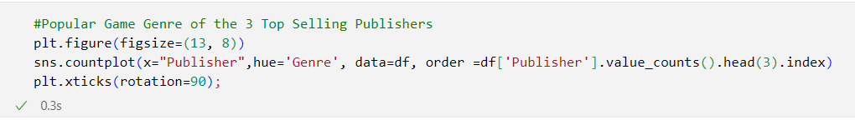
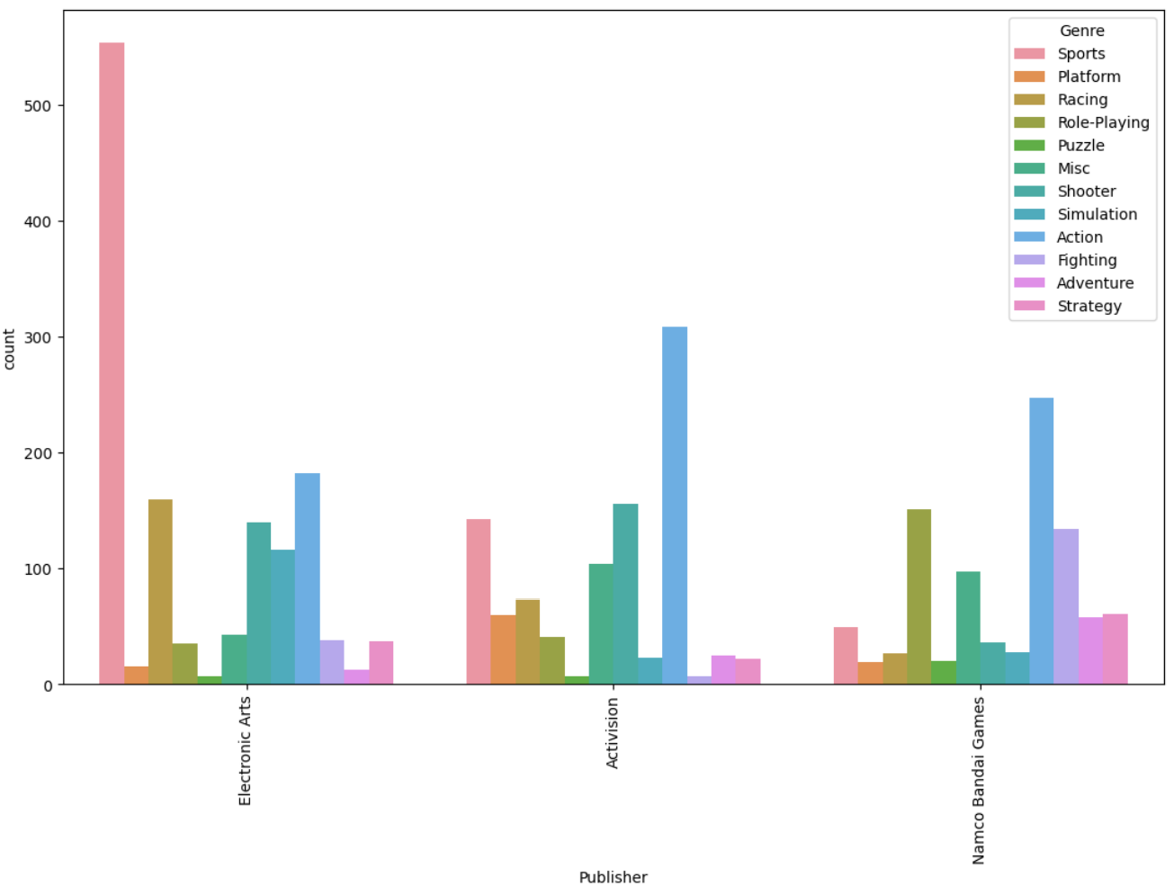
Popular game genres of top 3 publishers with more popular releases
Electronic Arts: Sports & Action
Activision: Action & Shooter
- Namco Bandai Games: Action & Role-playing

Slide 14
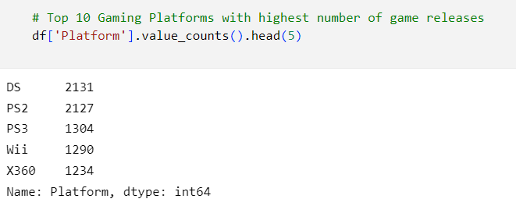
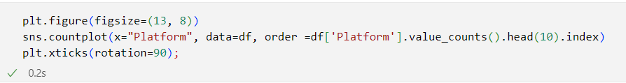
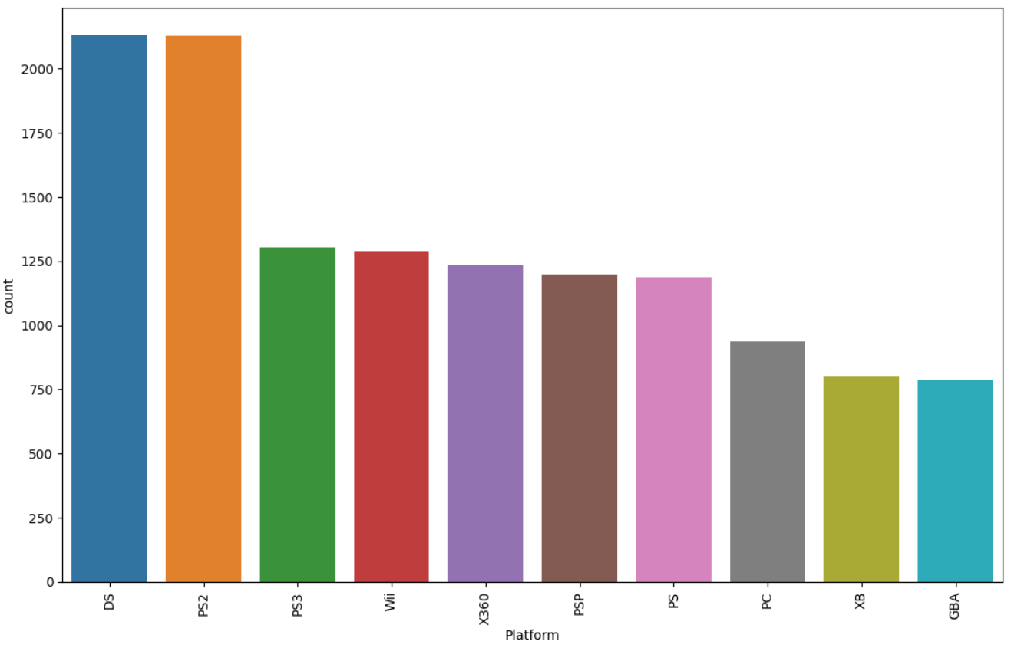
Top 10 Gaming Platforms with highest number of popular game releases
- DS and PS2 are the platforms with more popular titles, followed by PS3 and Wii

Slide 15
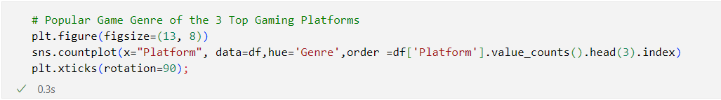
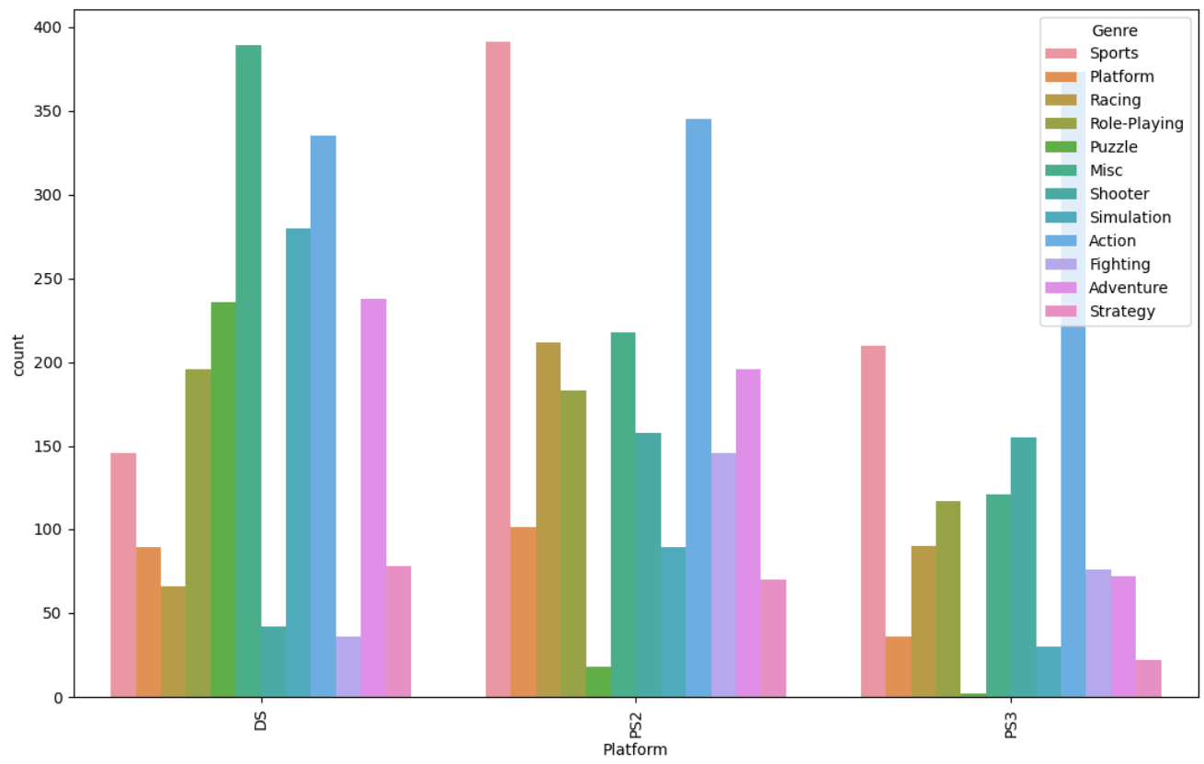
Popular Game Genres of the 3 Top Gaming Platforms
On DS stand out Misc, Action and Sim categories.
On PS2 we see Sports, Action and Puzzle.
On PS3 Action, Sports and Shooters.

Slide 16
Sales analysis
(Global)

Slide 17
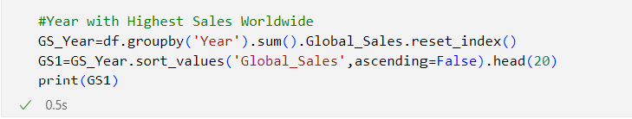
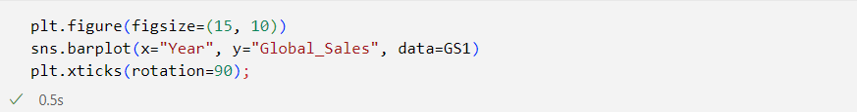
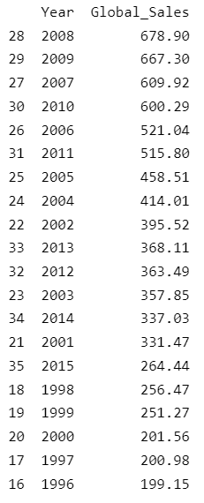
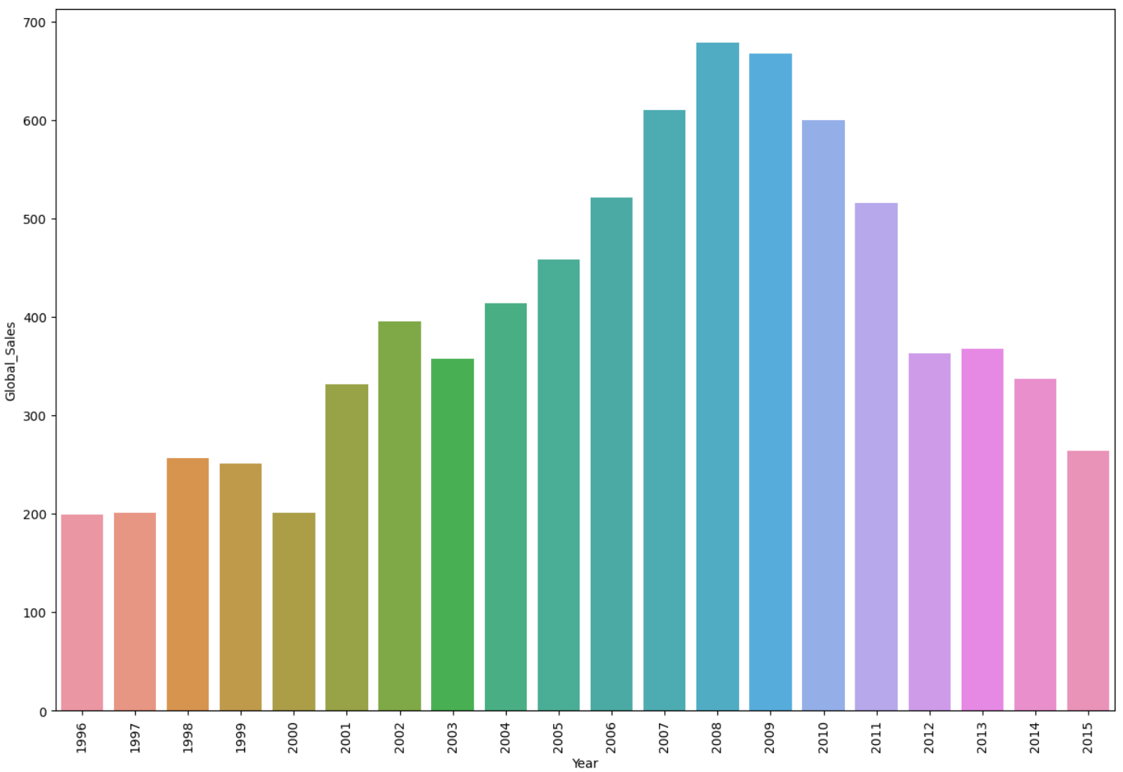
Year with Highest Sales Worldwide
- We observe the most selling years globally are between 2007 and 2010.
- This relates to this years also being the top most popular game releasing years

Slide 18
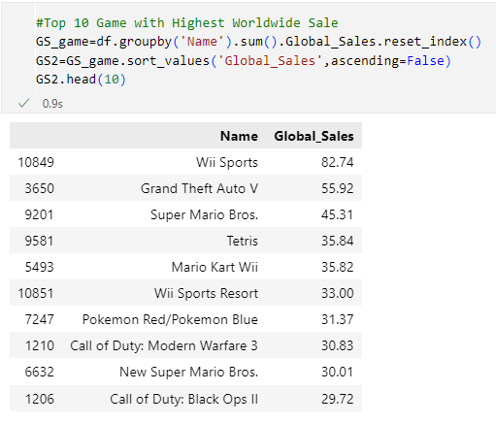
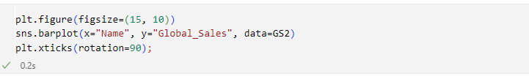
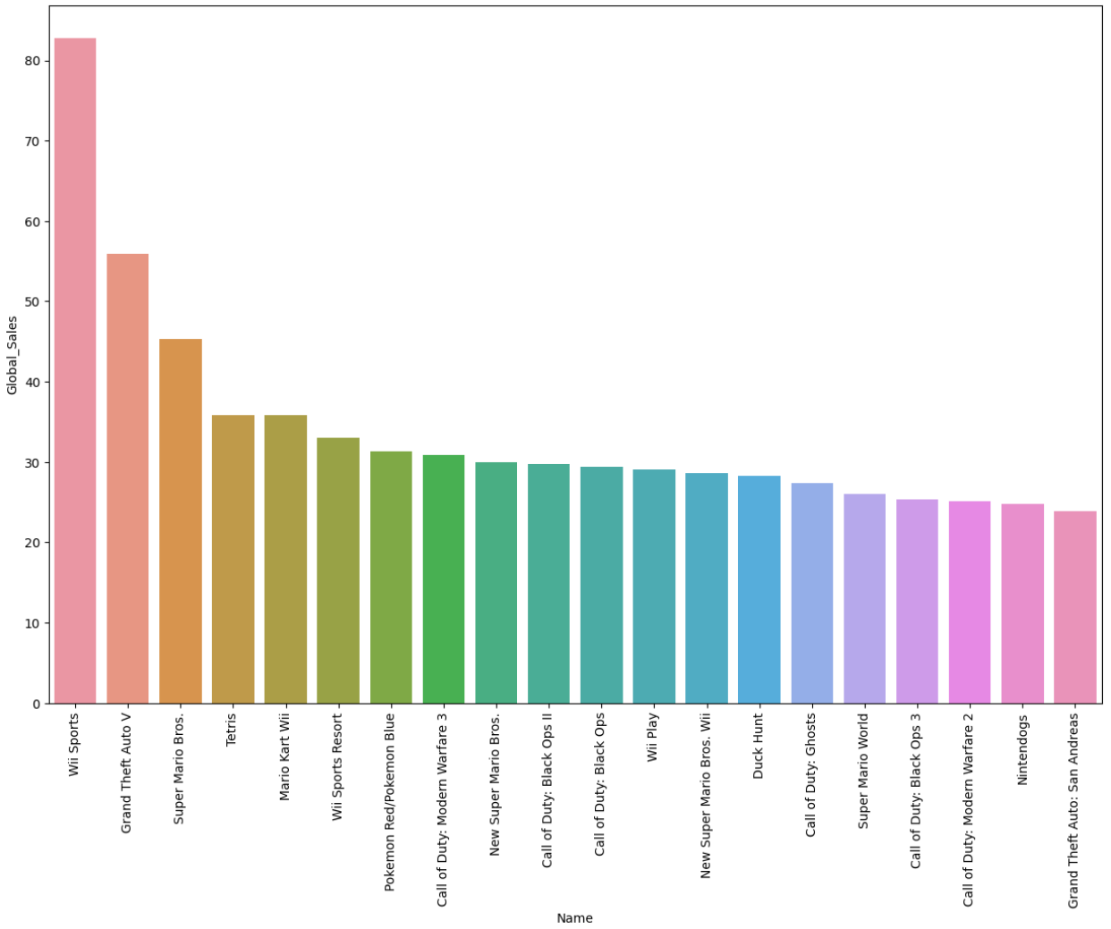
Top 10 Game with Highest Worldwide Sales
- Wii Sports, GTA V and Super Mario Bros appear as the most selling titles around the world

Slide 19
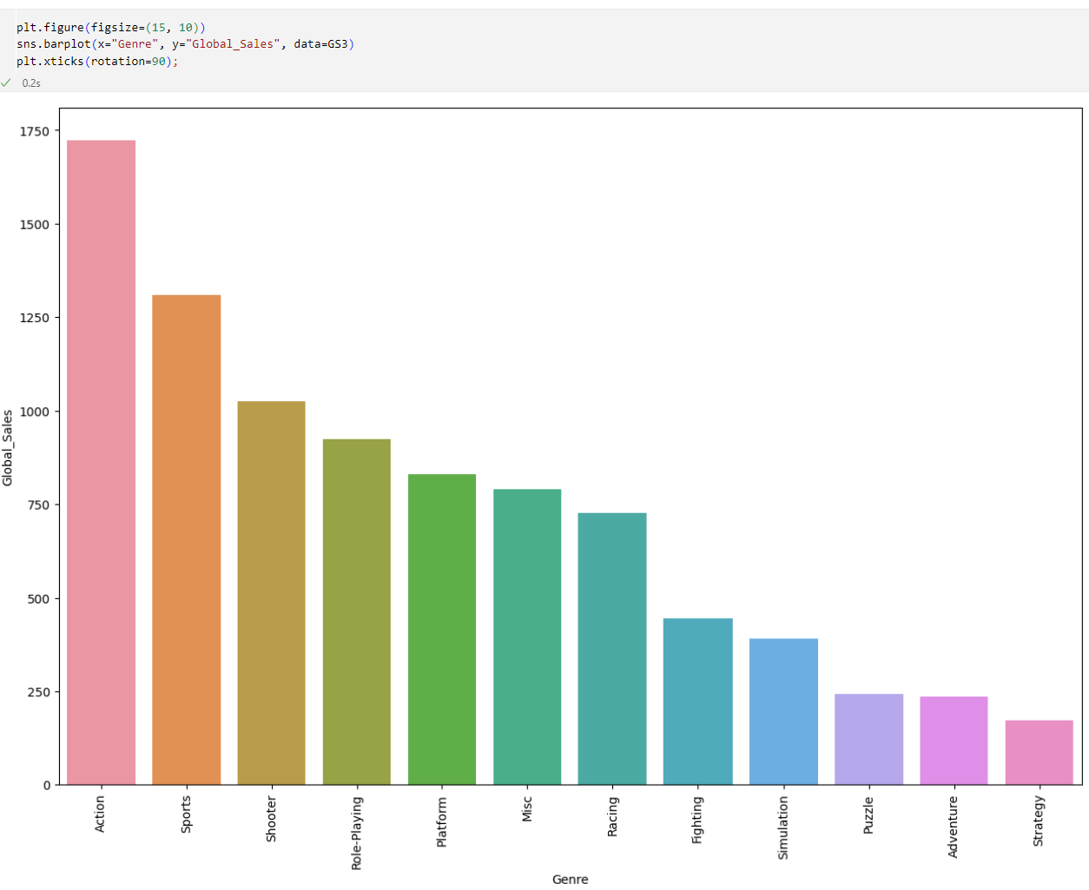
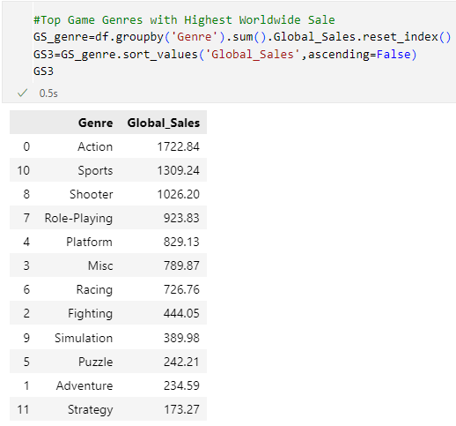
Top Game Genres with Highest Worldwide Sales
- In the global market Action and Sports dominate sales, as we can see.

Slide 20
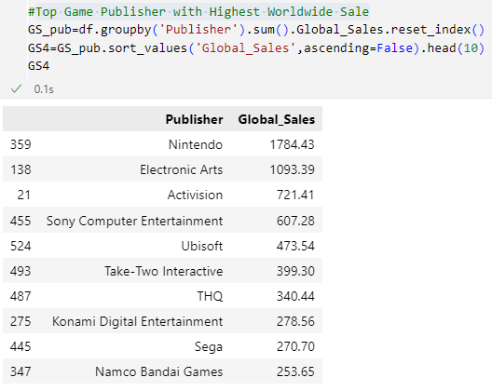
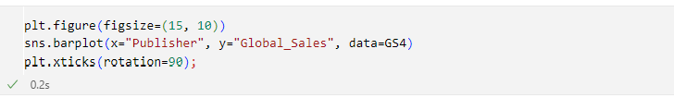
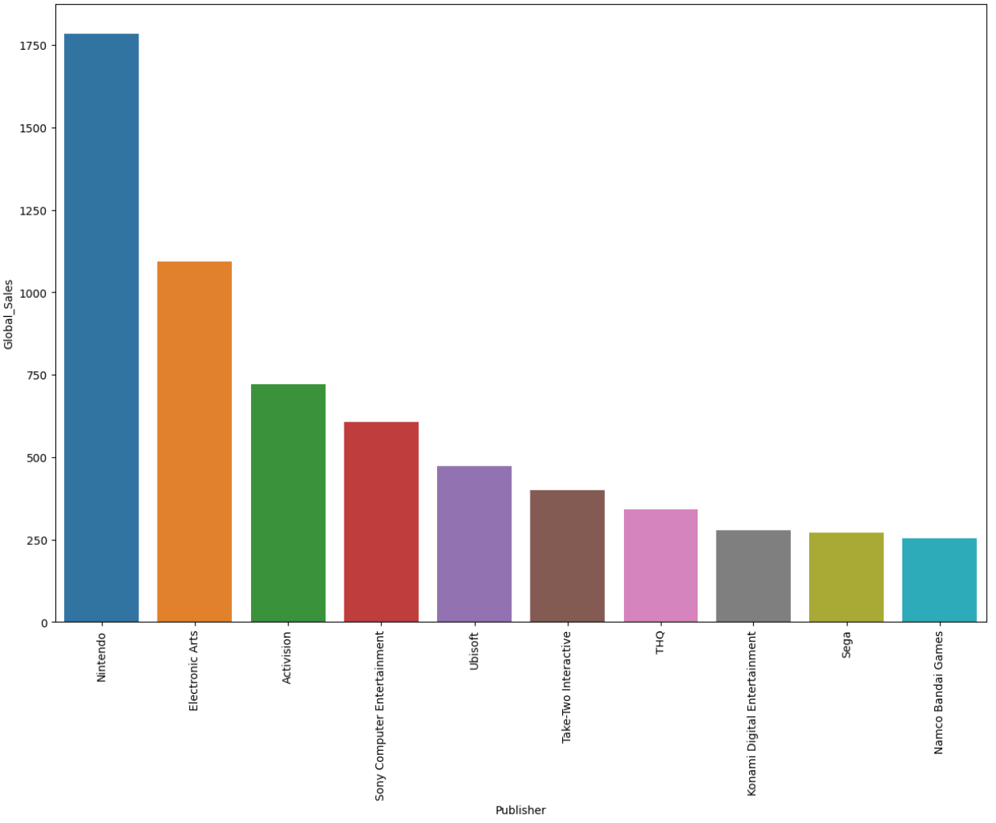
Top Game Publisher with Highest Worldwide Sales
- Here some of the most selling publishers in the globe, with Nintendo crushing the rest in terms of games sold.

Slide 21
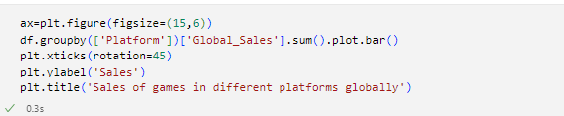
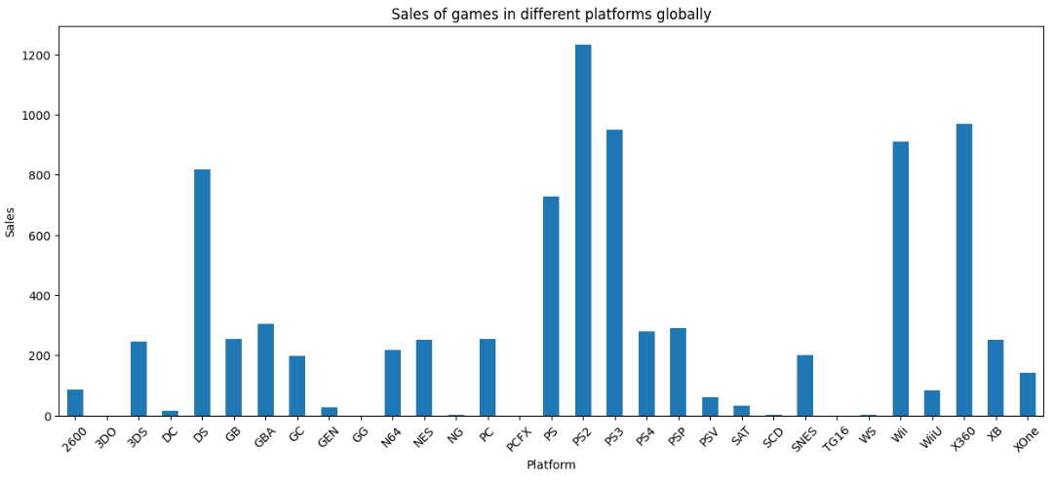
global sales for games on each platform
PS2 stands as the platform with more game sales around the world
It is followed by Xbox360, PS3 and Wii

Slide 22
Sales analysis
(on each area)

Slide 23
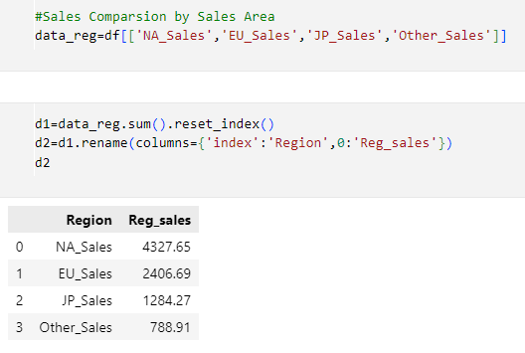
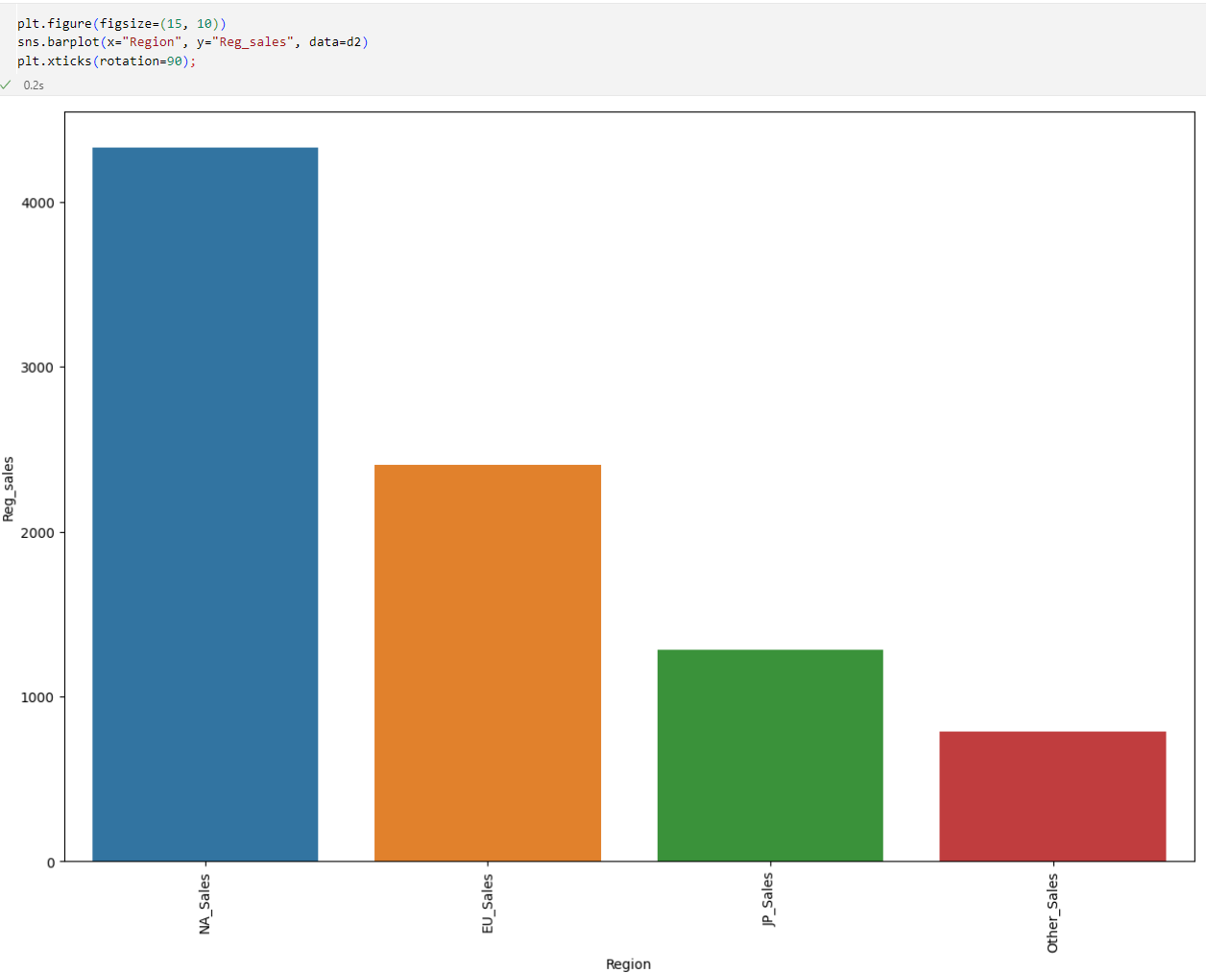
Sales Comparison by Area
- For its bigger demography and territory (as hypothesis) NA sales are way superior than sales in other territories.

Slide 24
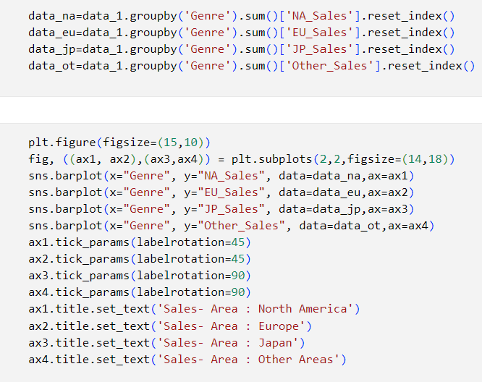
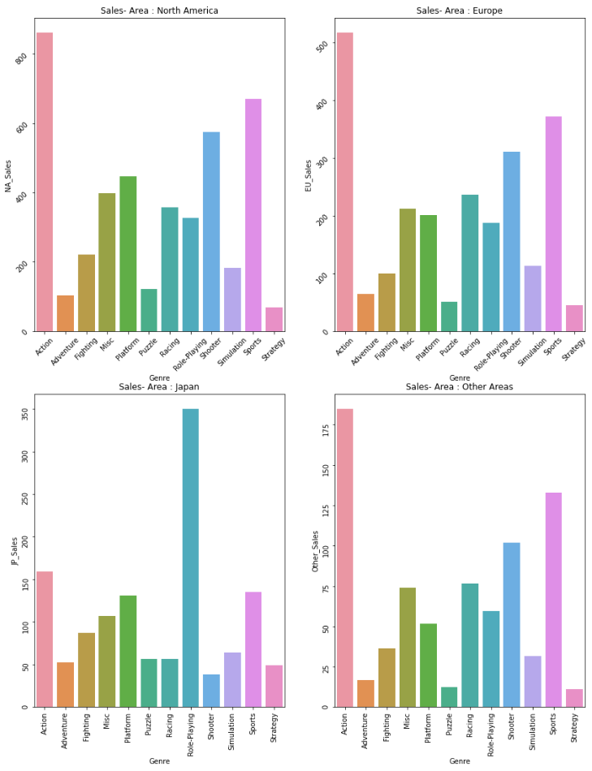
Top Selling genres by region
NA: Action, Sports
Europe: Action, sports
Japan: Role-playing, Action
Other: Action, Sports

Slide 25
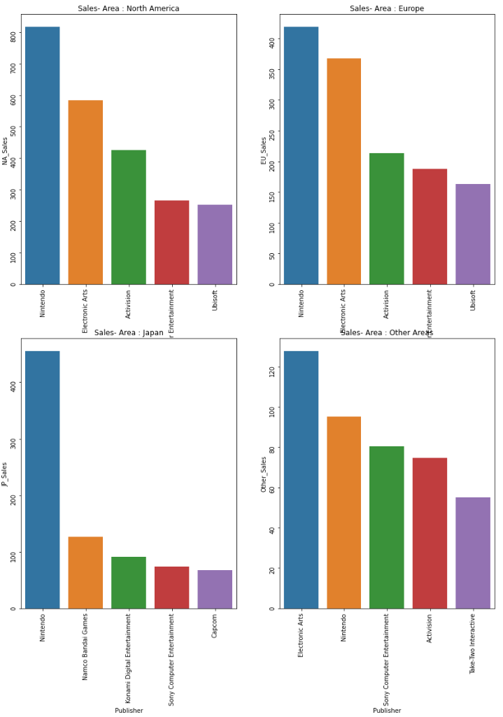
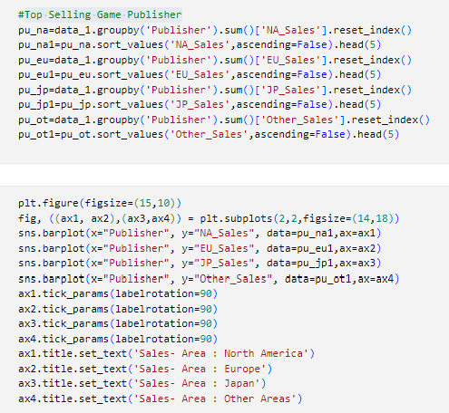
Top Selling Game Publisher
NA: Nintendo, EA
Europe: Nintendo, EA
Japan: Nintendo, Bandai-Namco
Other: EA, Nintendo

Slide 26
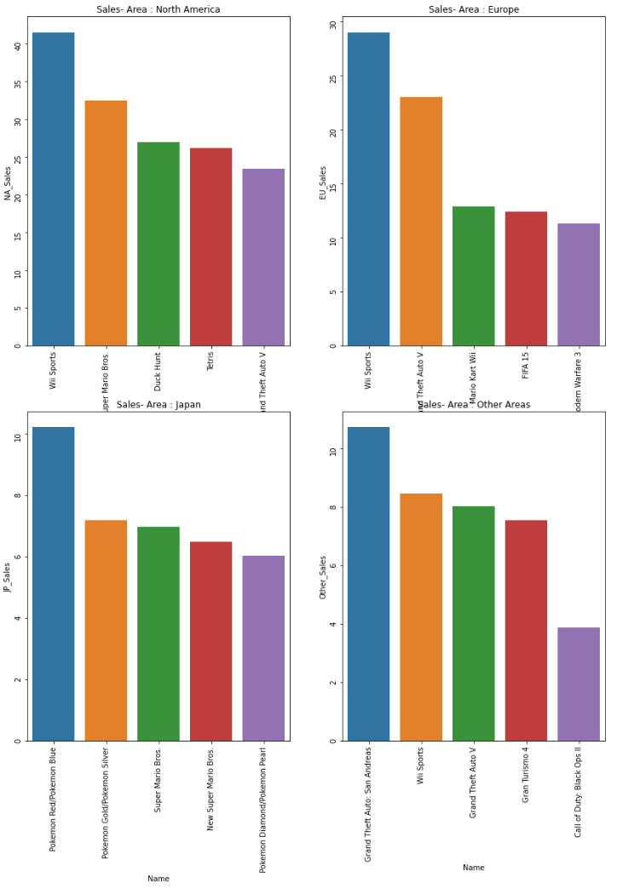
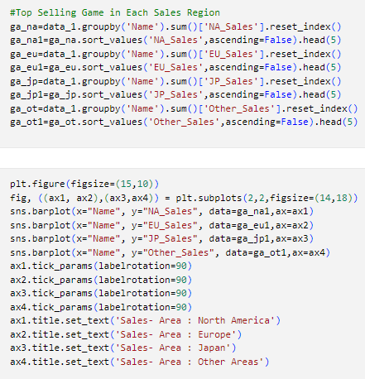
Top Selling Game in Each Sales Region
NA: Wii Sports, S Mario Bros
Europe: Wii Sports, GTA V
Japan: Pokemon Red/Blue, Gold/Silver
Other: GTA San Andreas, Wii Sports

Slide 27
Building machine learning models
We faced a regression problem in which we want to predict if a video game would reach certain number of sales in the global market.
We tried different models and compare their score to see which one fitted better.

Slide 28
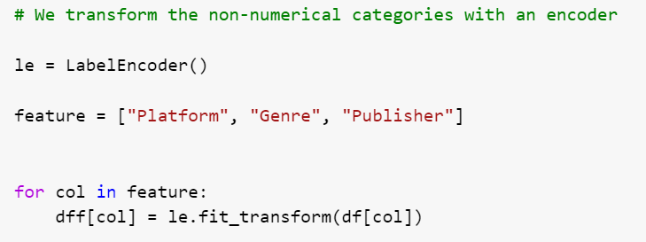
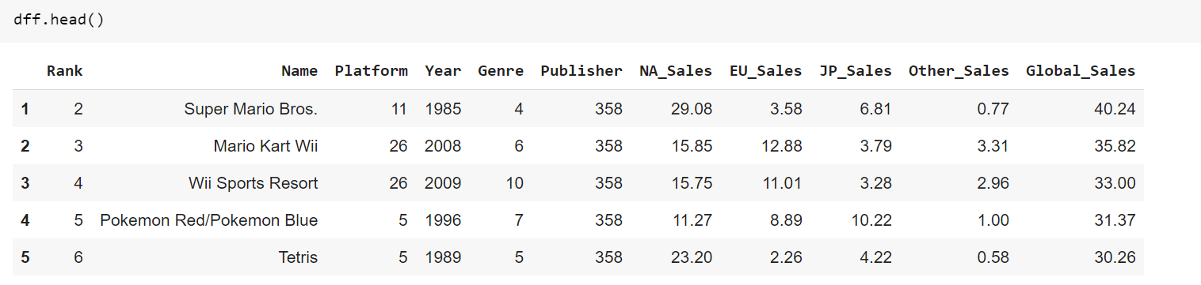
PREPROCESSING STEPS
- We transformed non numerical columns into numerical with an encoder

Slide 29
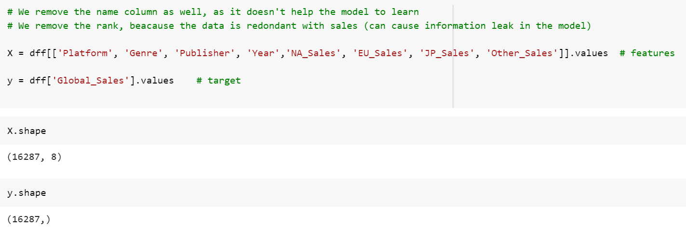
Choosing featrures and target and splitting into train and test samples

Slide 30
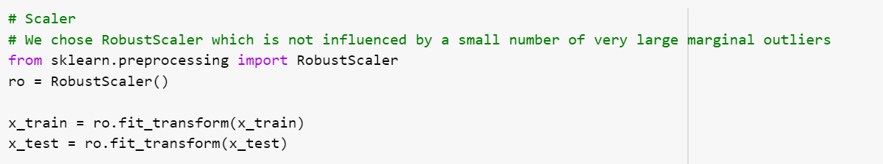
scaling
- We chose RobustScaler rather tan StandarScaler, as it is not influenced by a small number of very large marginal outliers

Slide 31
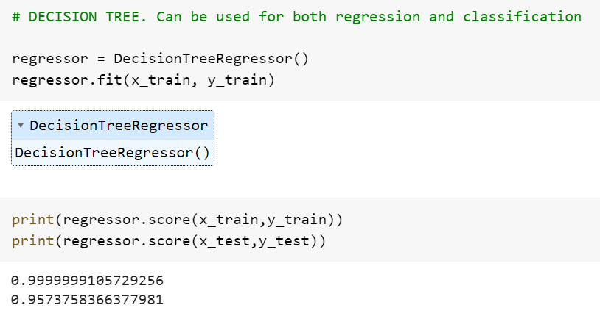



Model 1: decision tree

Slide 32




Model 2: Ridge regression

Slide 33




Model 3: linear regression

Slide 34




Model 4: random forest

Slide 35




Model 5: knn (k neighbors)

Slide 36
CONCLUSION
We see that the years with more popular games released are also the ones with larger amount of sales worldwide.
The platforms with more popular games released (DS, PS2) are not the only ones with the largest number of games sold (PS3, Wii, Xbox360 too).
We also see that the most important Publisher in terms of total sales (Nintendo) is not the one with more popular games released (EA).
The most important region in terms of sales is clearly North America, followed by Europe.

Slide 37
CONCLUSION
As we see, the best performing models of the above are linear regression and ridge regression models, based on the scores obtained by all of them.
Nonetheless, how much a videogame would sell in the actual market depends on many factors, such us, for example, the trends in the pop culture or the technology implemented on it.

